Slide 1
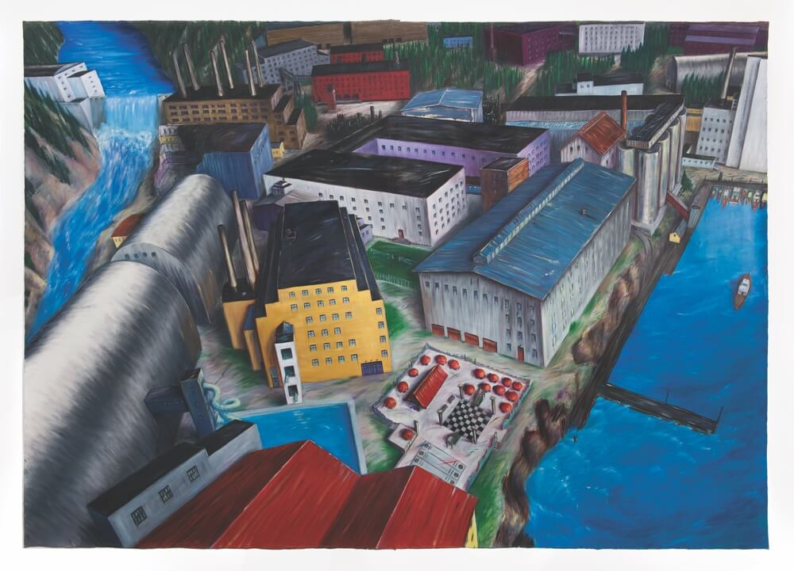
Eleanor Bond
IV Converting the Powell River Mill to a Recreation and Retirement Centre
1985
Oil on canvas

Slide 2
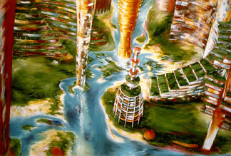
Eleanor Bond

Slide 3
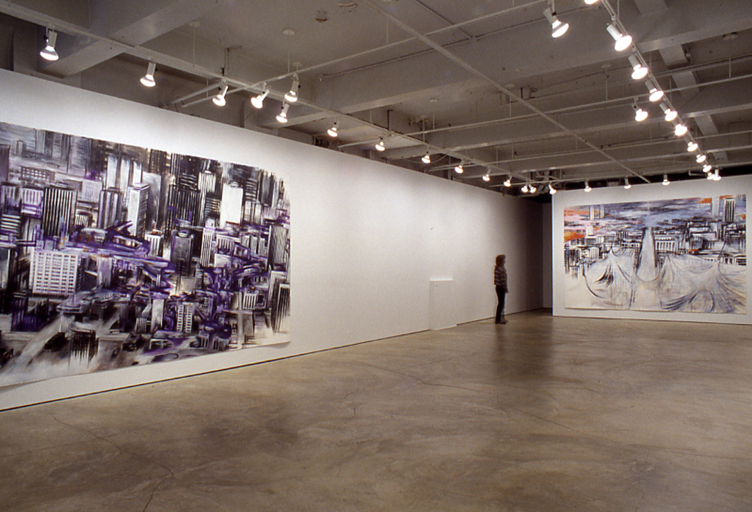
N
Eleanor Bond
Installation view

Slide 4
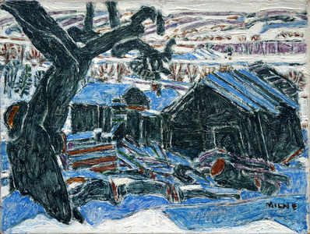
David Milne
Abandoned House
1922
Oil on canvas
12 × 15 in

Slide 5
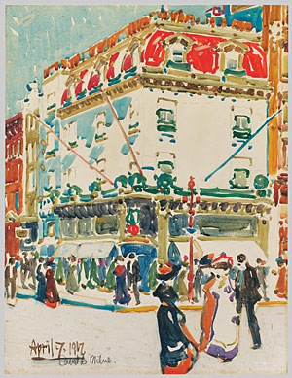
David Milne
Fifth Avenue, Easter Sunday
1912
Watercolor over graphite on illustration board; 22 1/2 x 17 1/4 in.

Slide 6
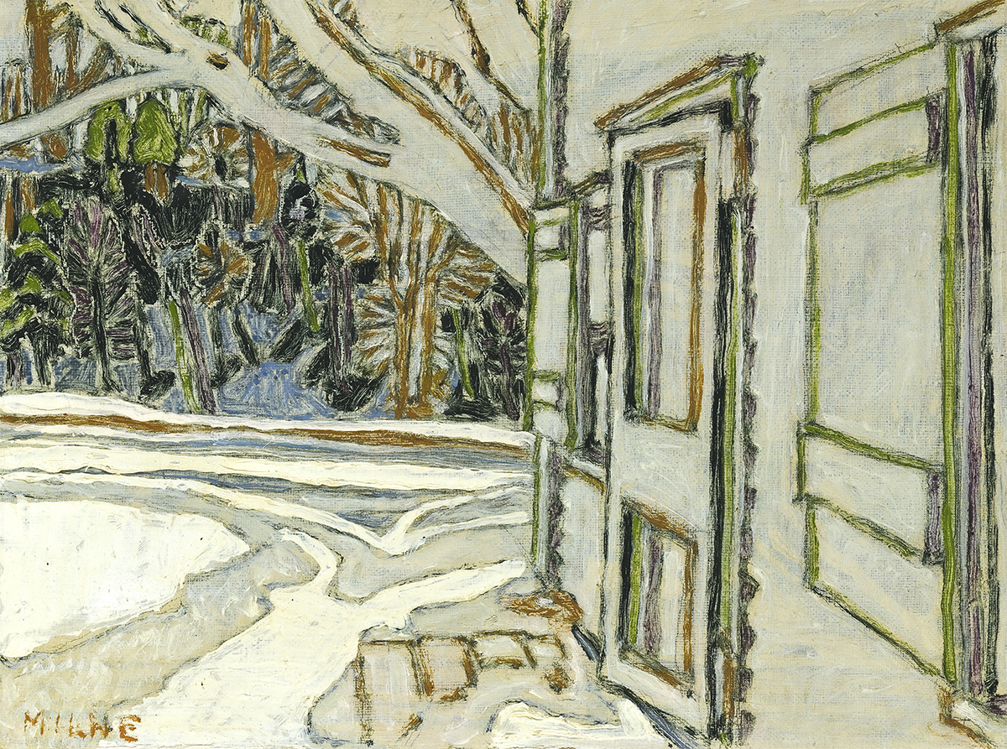
David Milne
Side Door, Clarkes House, c.1923
Oil on canvas

Slide 7
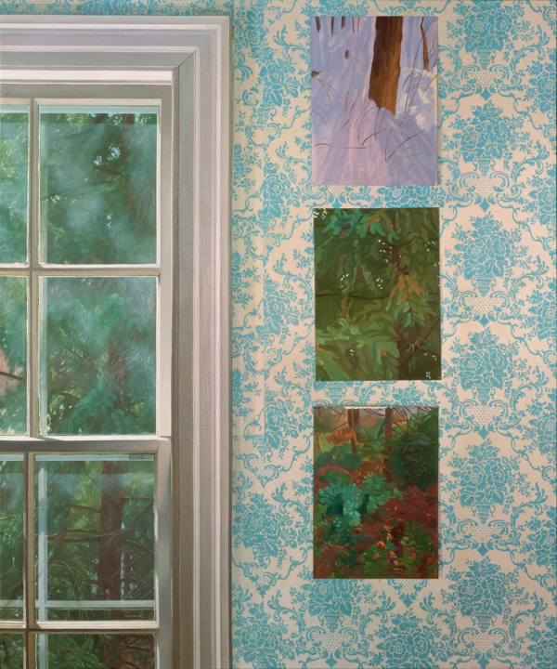
Catherine Murphy
Paintings for Paintings
1989
Oil on canvas
47 x 39 in.

Slide 8
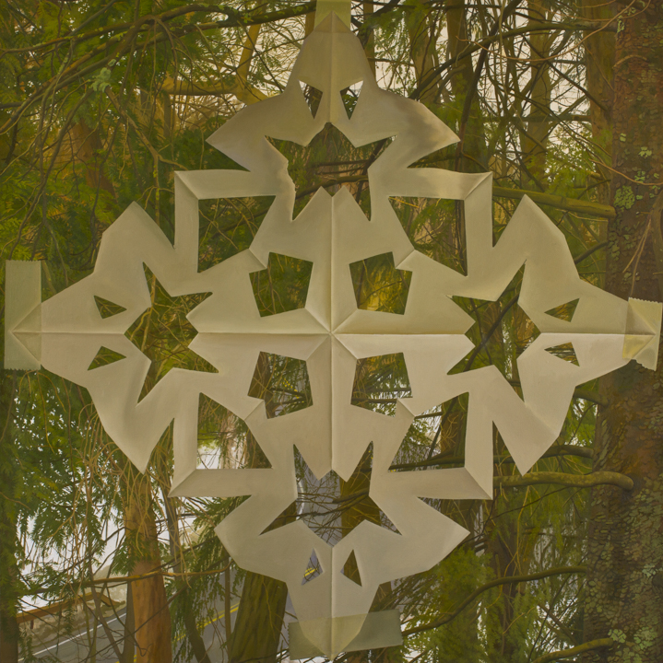
Catherine Murphy
Snowflake
2012
Oil on canvas
52 x 52 in.

Slide 9
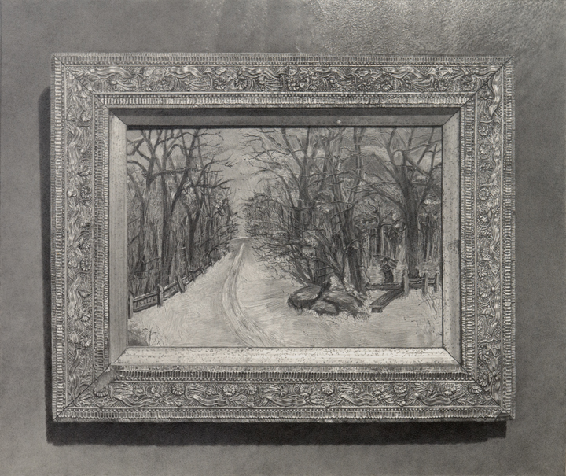
Catherine Murphy
Early Influence
2012
Graphite on paper
24 3/8 x 28 7/8 in.

Slide 10
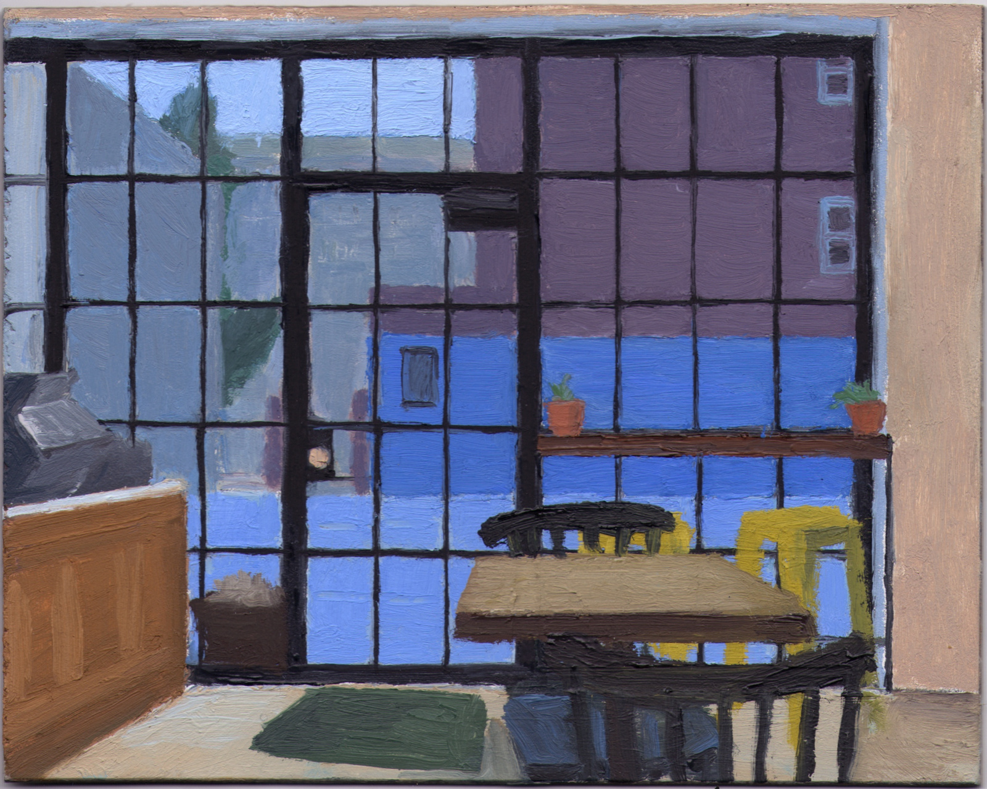
Eleanor Ray
February Windows
2014, Oil on Panel, 5 3/8 x 6 7/8"

Slide 11
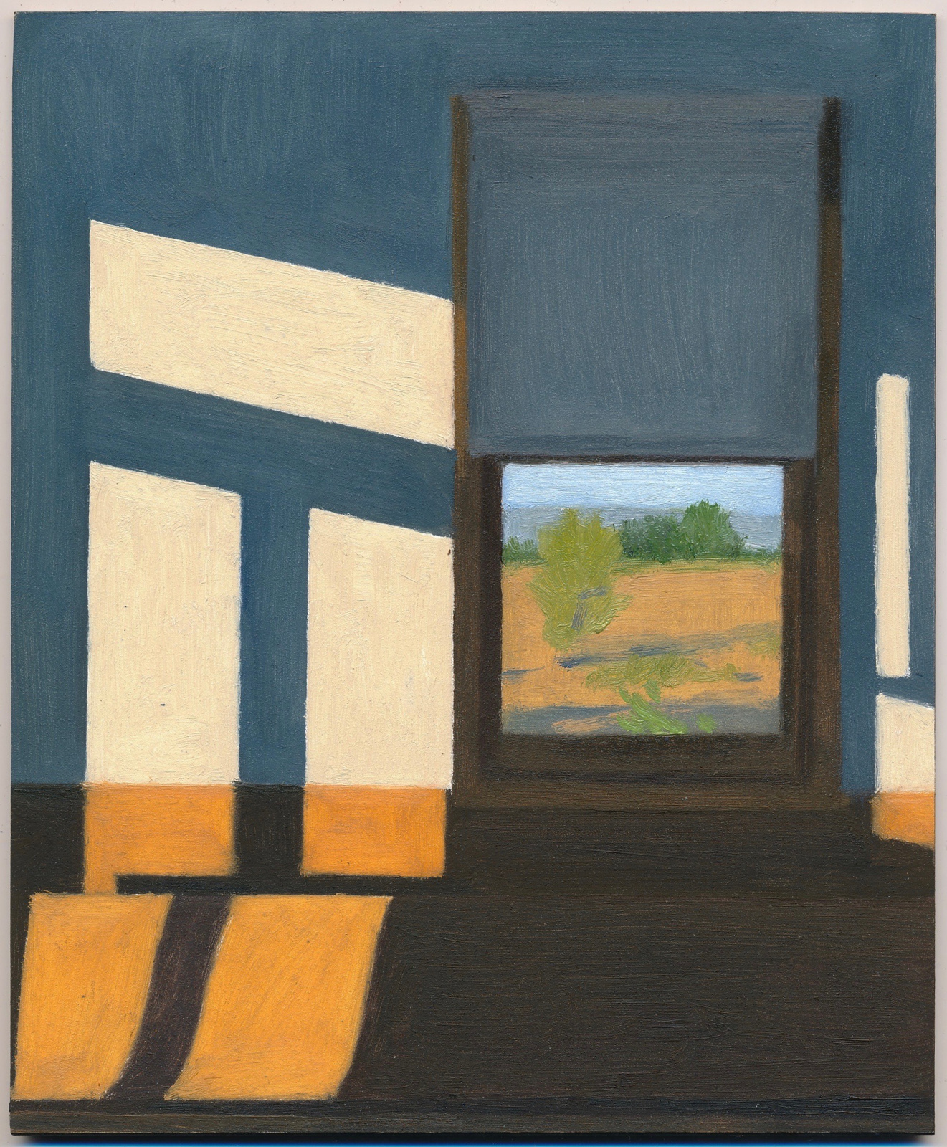
Eleanor Ray
Untitled
2018
Oil on panel, 8 x 6 1/2 inches

Slide 12
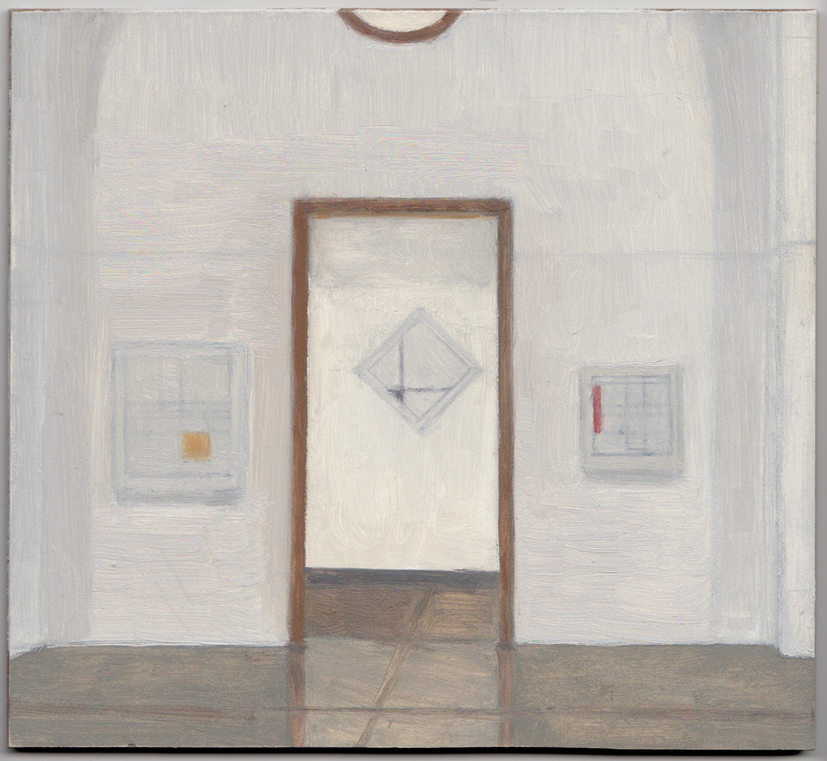
Eleanor Ray Mondrian Room, 2016

Slide 13
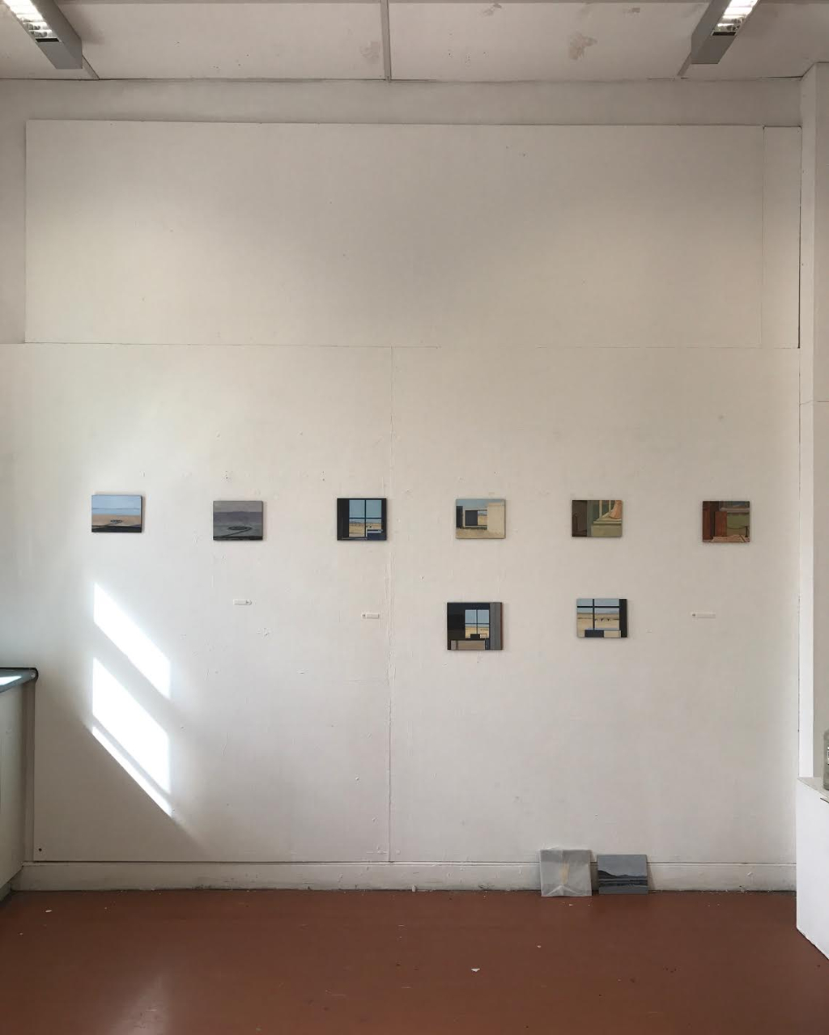
Eleanor Ray
Installation view

Slide 14
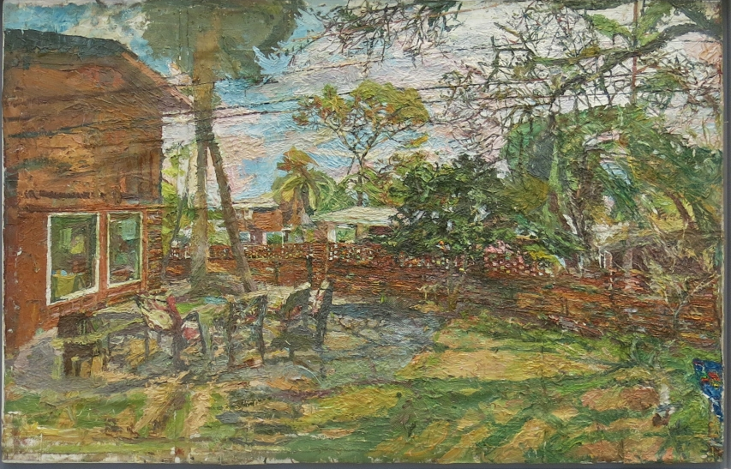
Stanley Lewis
Backyard Jeykll Island, GA
2014
Oil on canvas

Slide 15
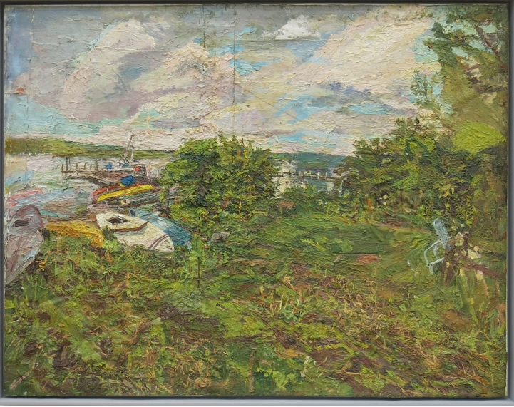
Stanley Lewis
Boat on the Beach, Lake Chautauqua
2013
Oil on canvas

Slide 16
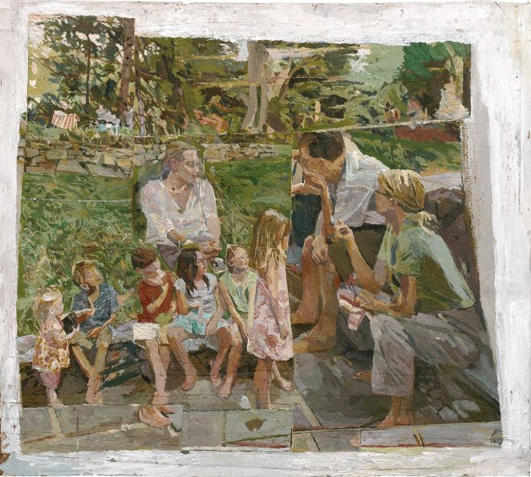
Stanley Lewis
Family Group
2014-2018
Acrylic on canvas

Slide 17
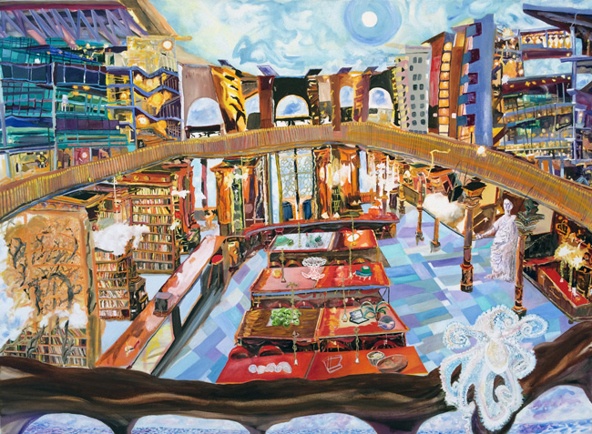
Olive Ayhens
"Oceanic Library"
2014
Oil on canvas
35"x48"

Slide 18
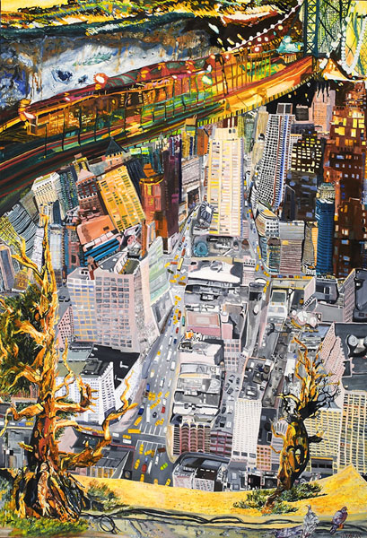
Olive Ayhens
"Bristlecones on the Balcony"
2003-04
Oil on linen
75"X59"

Slide 19
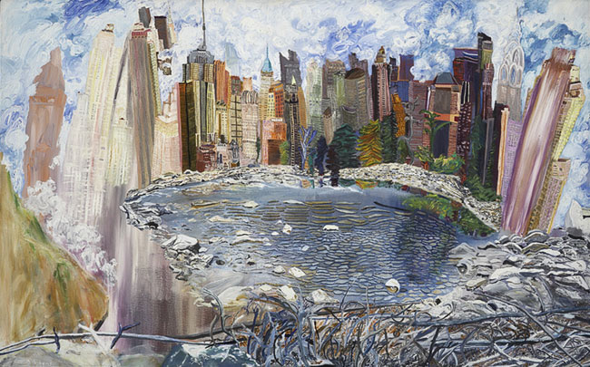
Olive Ayhens
"Edge City"
1998
Oil on canvas
40"X56"

Slide 20
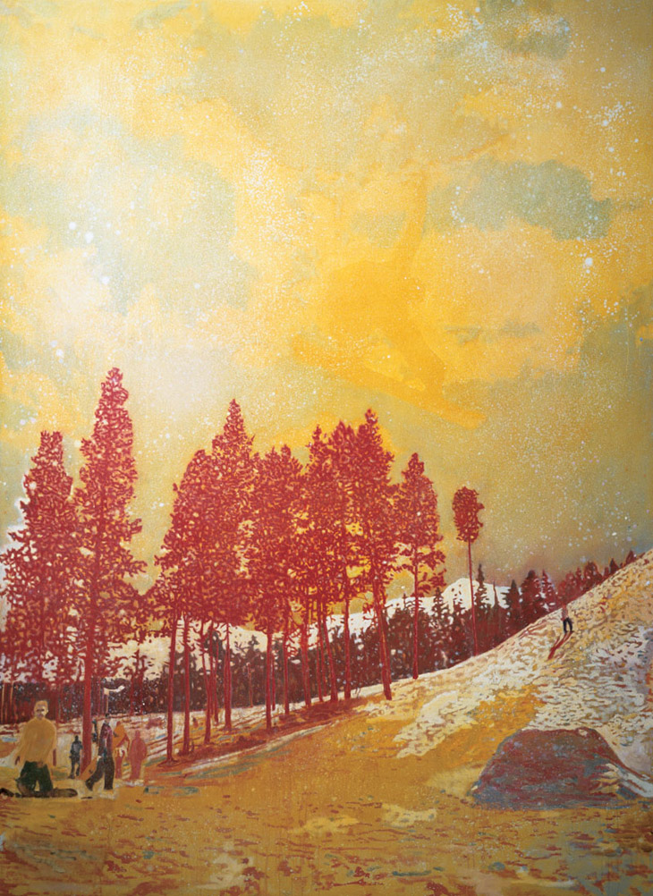
Peter Doig
Orange Sunshine
1995
Oil on Canvas
276 x 201cm

Slide 21
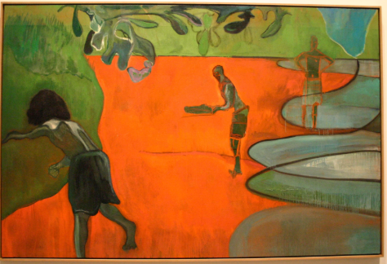
Peter Doig
Paragon
2006
Oil on canvas

Slide 22
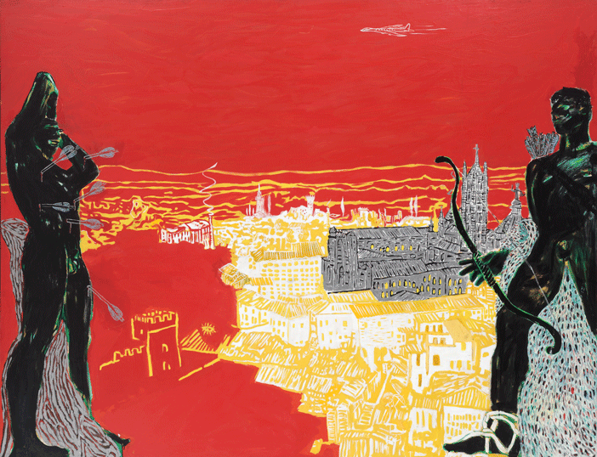
Peter Doig
Red Sienna
1985

Slide 23
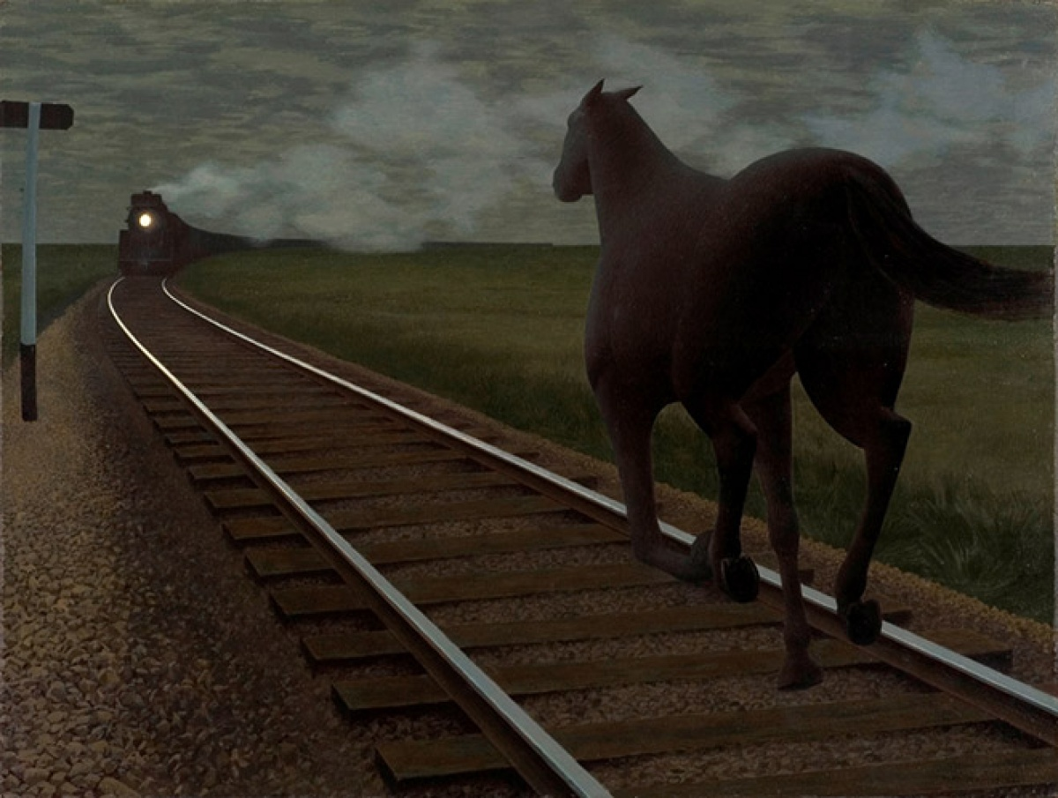
Alex Colville
Horse and Train
1954
Glazed oil on hardboard

Slide 24
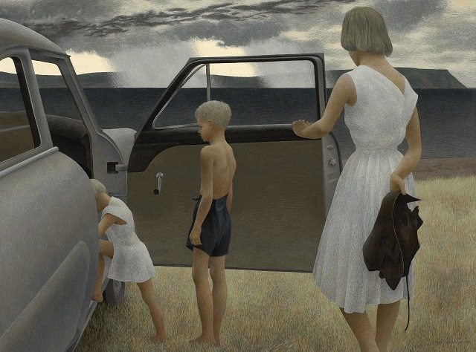
Alex Colville
Family and Rainstorm
1955
Tempera on masonite

Slide 25
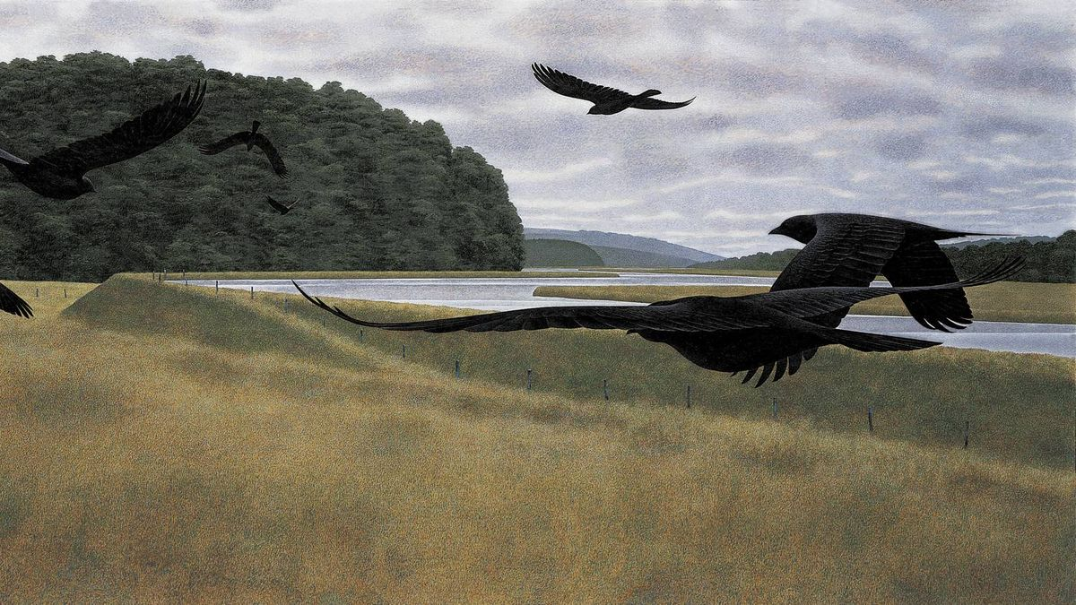
Alex Colville
Seven Crows
1980
Acrylic polymer emulsion on hardboard

Slide 26
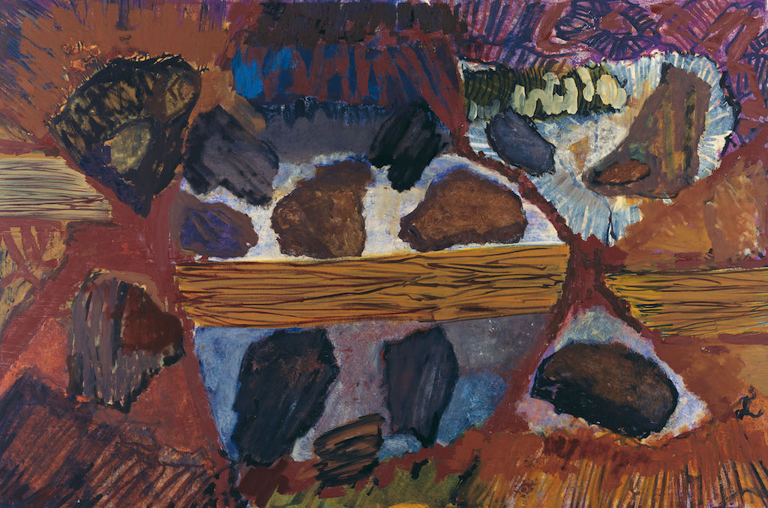
Per Kirkeby
Untitled
2005
Tempera on canvas
78.7 × 118.1 in.

Slide 27
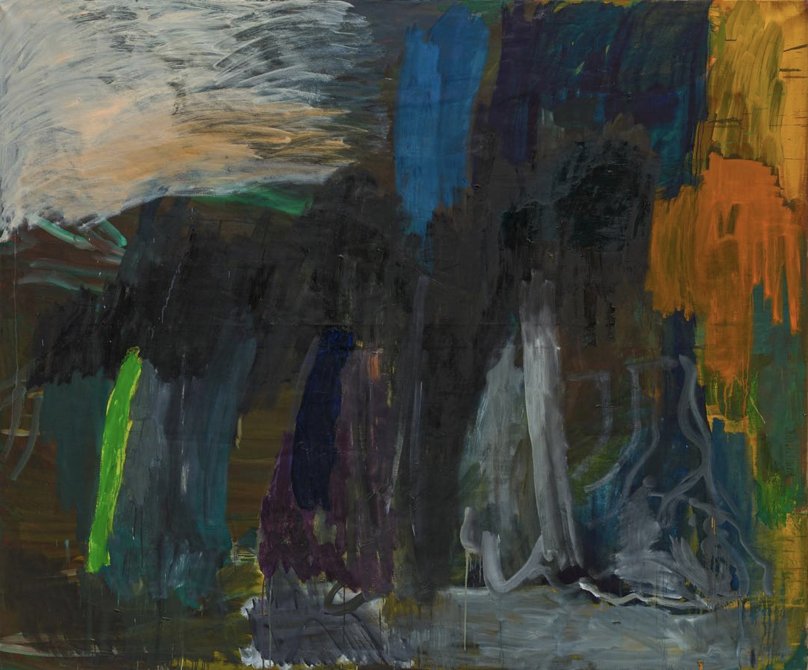
Per Kirkeby

Slide 28
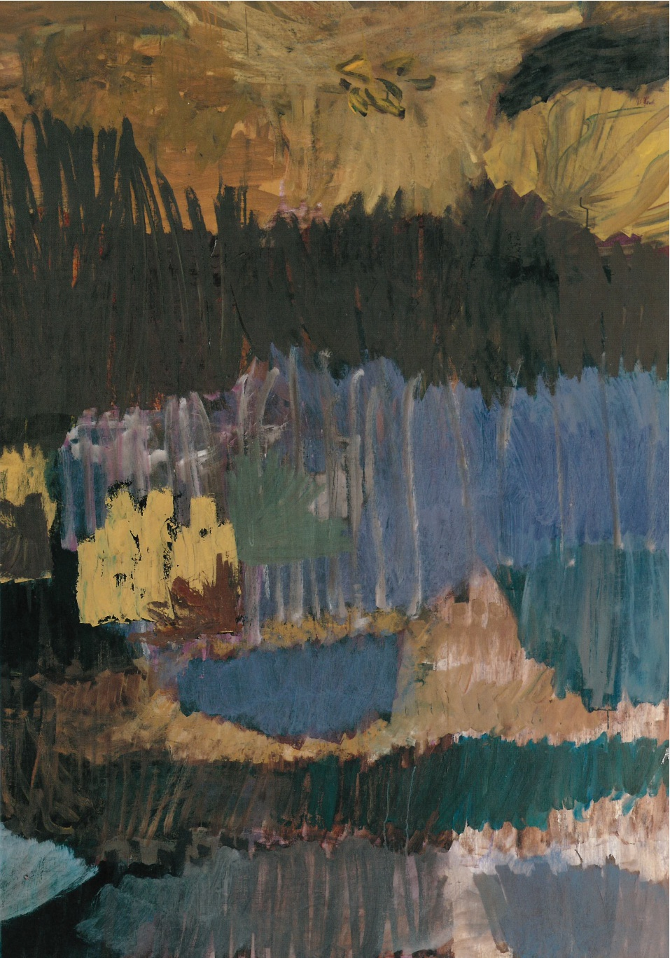
Per Kirkeby

Slide 29
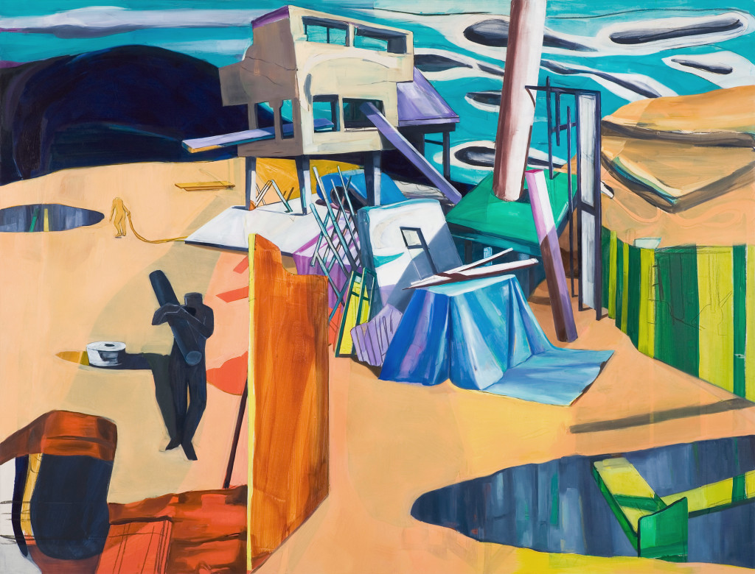
Medrie MacPhee
Outpost
2007
Oil on canvas (64 x 84 in.)

Slide 30
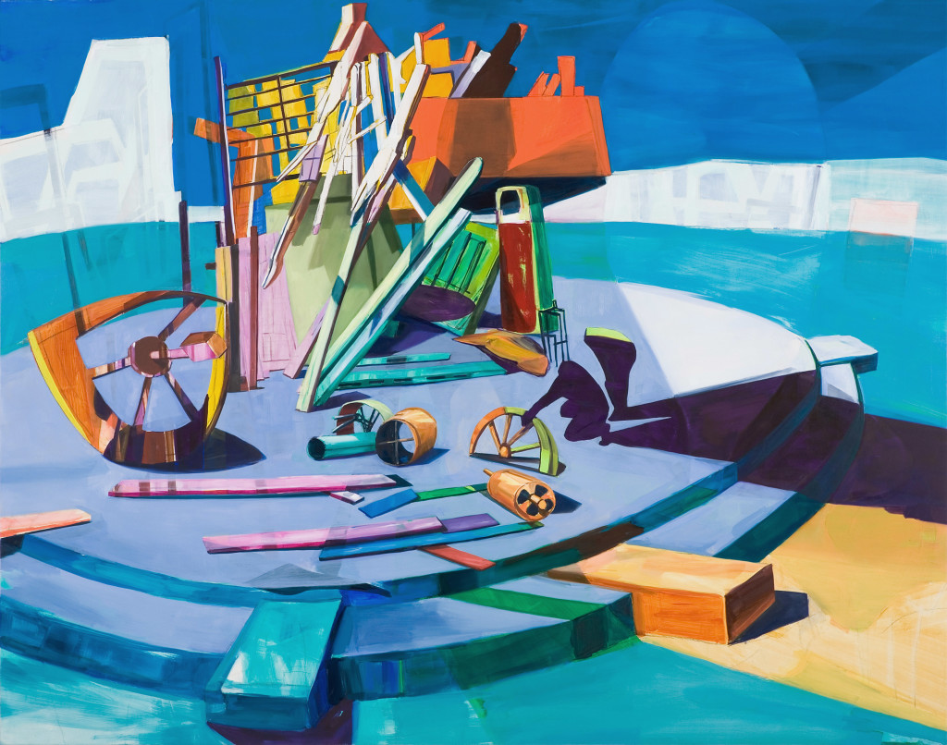
Medrie MacPhee
The Last Gas Station on Earth
2006
Oil on canvas
64 x 80 in.

Slide 31
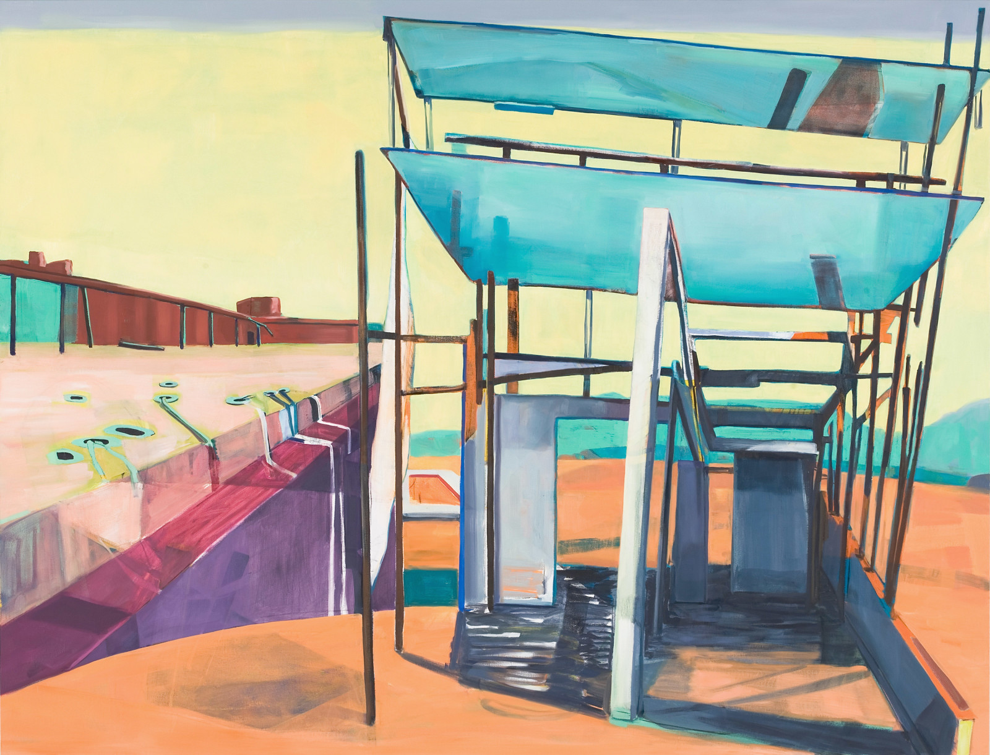
Medrie MacPhee
De Maisonneuve
2006
Oil on canvas
64 x 84 in.

Slide 32
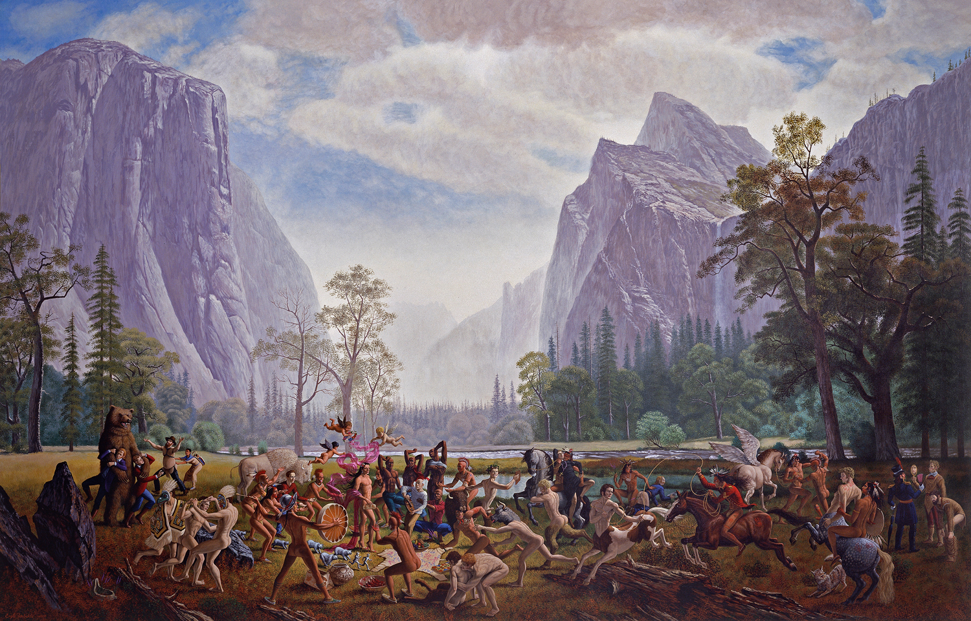
Kent Monkman
The Triumph of Mischief
2007
Acrylic on canvas, 213 x 335 cm

Slide 33
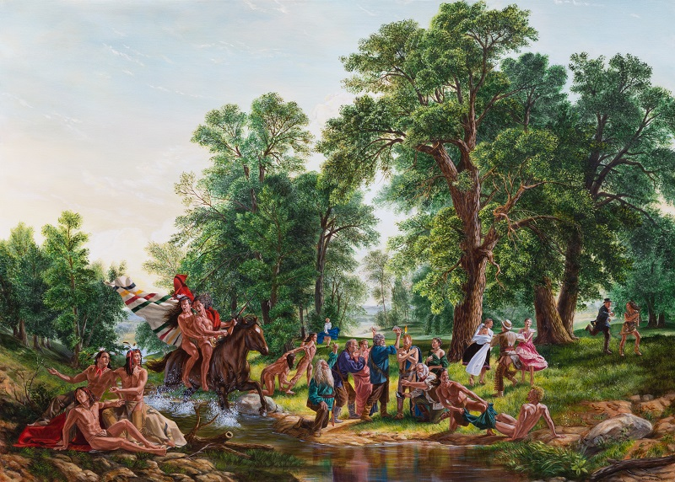
Kent Monkman
Baptism by Fire
2017
Acrylic on canvas

Slide 34
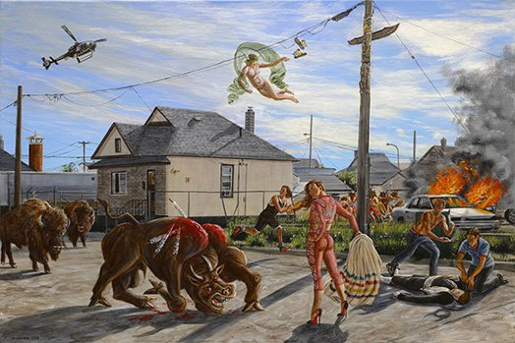
Kent Monkman
Study for Seeing Red
2014
Acrylic on canvas
24" x 36"

Slide 35
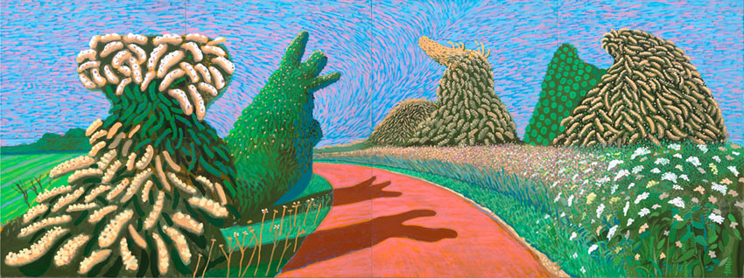
David Hockney
May Blossom on the Roman Road
2009

Slide 36
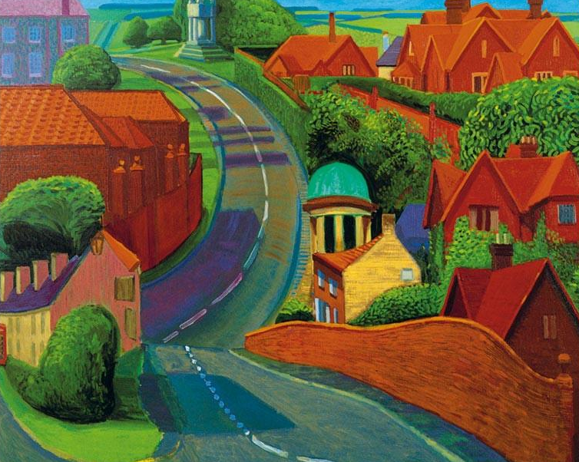
David Hockney
The Road to York through Sledmere
1997
Oil on canvas
48x60 in.

Slide 37
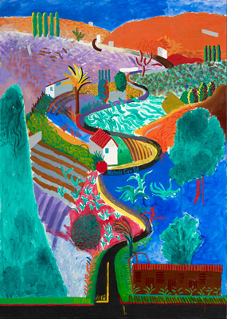
David Hockney
Nichols Canyon
1980
Acrylic on canvas
84x60 in

